Slide 1


IMDB Ratings Decoded: What Makes Movies Stand Out?
Group 10
Aditya Kanhere (kanhere3)
Ananya Shukla (shukla6)
Anushree Raipat (araipat2)
Parv Rustagi (parvr2)
Pragyesh Rastogi (pr28)
Vidisha Tiwari (vtiwari4)

Slide 2

Exploring How IMDB Ratings Work?
IMDB ratings serve as a valuable guide for viewers.
What factors truly influence a movie's success on IMDB?
This analysis explores the relationships between various movie attributes and their IMDB scores.

Slide 3

Understanding The Dataset
This analysis is based on a dataset containing information about a top 1000 movies based on IMDB ratings.
The dataset encompasses a wide range of movie attributes, including:
IMDB Rating (the target variable)
Release Year
Certificate
Runtime
Genre
Director(s)
Cast (lead actors)
Overview (brief description of the movie)
Meta score (another movie rating metric)
Gross Revenue (financial performance)

Slide 4
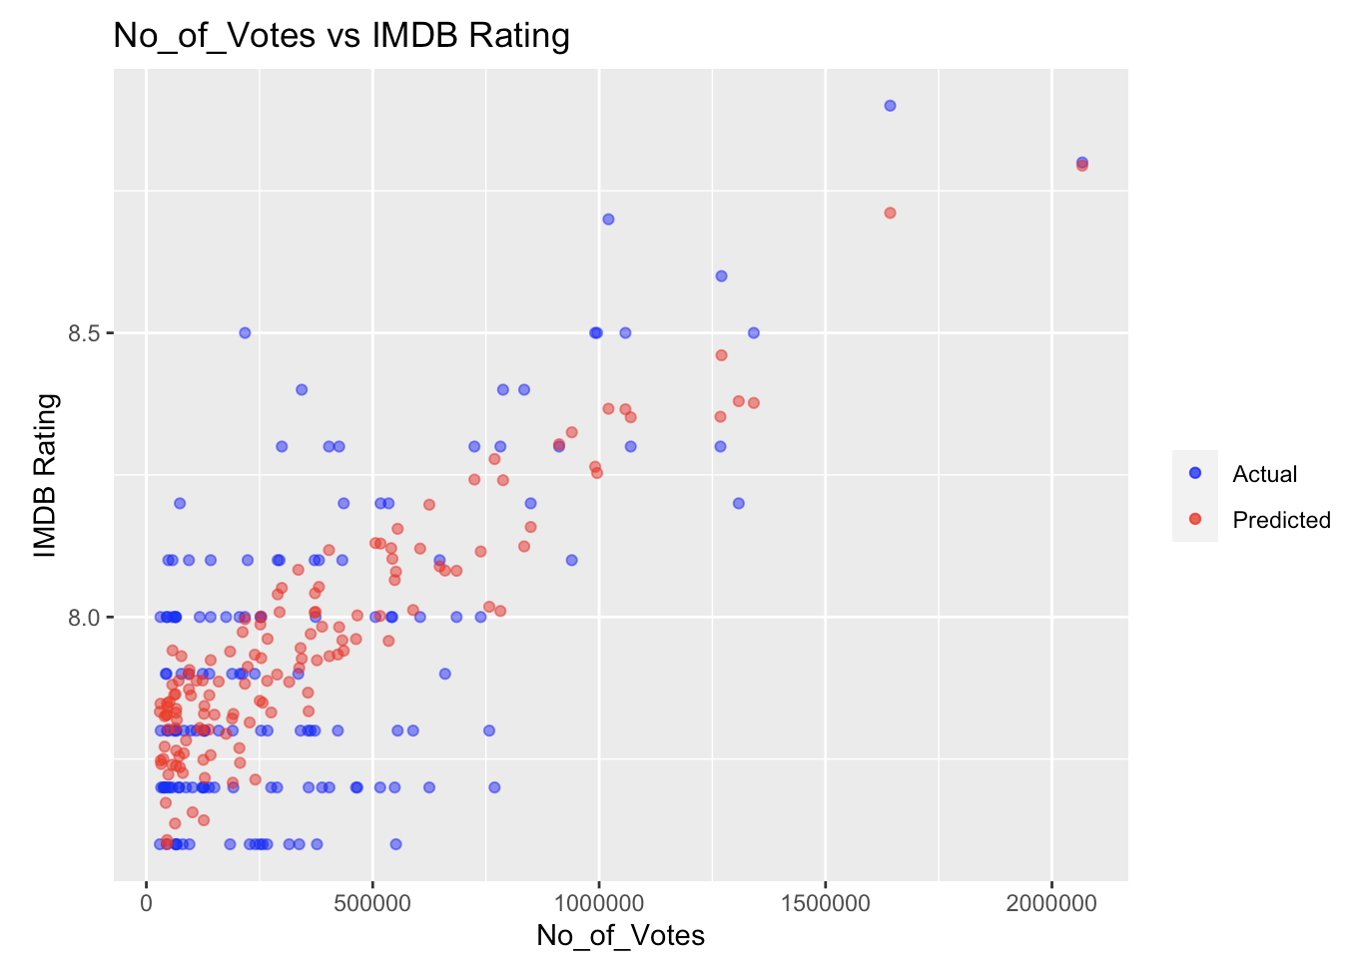
Visualization: Linear Regression Model
Scatter plot shows IMDb ratings vs. No. Of votes. Blue points depict actual ratings, red points show predictions. RMSE is 0.0926. Connection between votes and ratings is good but not perfect. Implications: RMSE of 0.09 indicates reasonable prediction using votes, yet other factors contribute to deviations from predictions on the 1-10 IMDb scale.

Slide 5
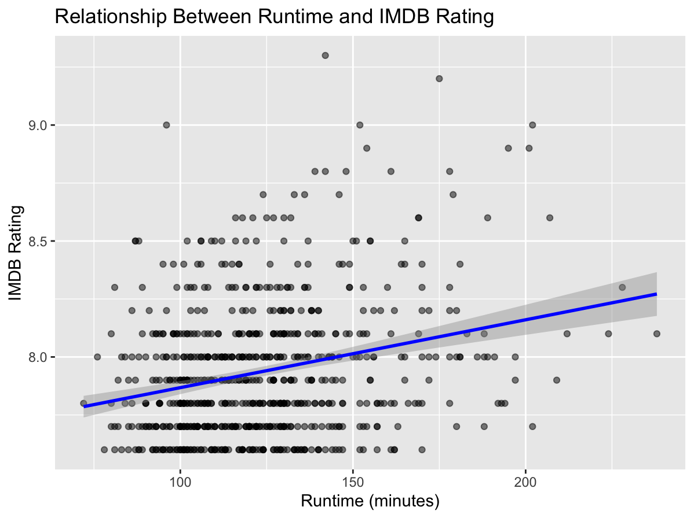
Visualization
Positive correlation found between movie length (runtime) and IMDb rating, suggesting longer films generally receive higher ratings. Confidence interval indicates variability, not all movies follow this trend. Data concentrated in 80-140 minutes range, typical for feature films. High IMDb ratings (>8.5) show diverse runtimes, implying factors beyond length impact ratings. Results suggest viewer perception of quality in longer, comprehensive films, influenced by expectations for storytelling, character development, and production value. Genre differences in typical runtimes may contribute to higher ratings.

Slide 6
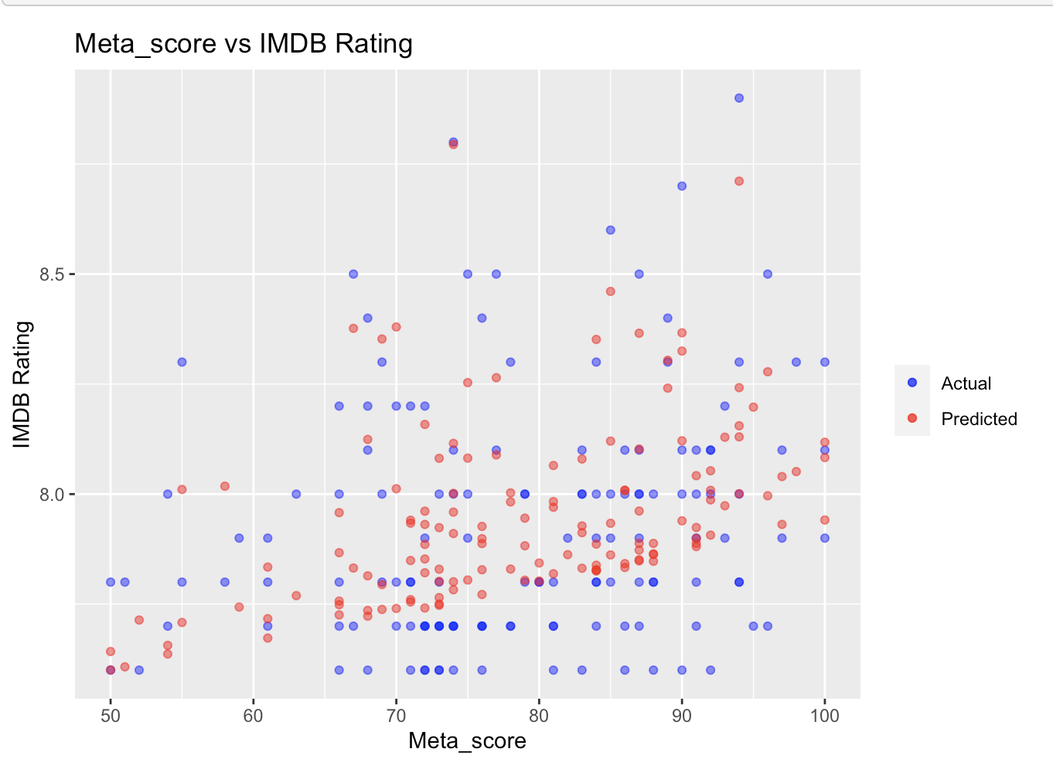
Visualization: Linear Regression Model
The scatter plot compares actual IMDb ratings with the Meta scores. Blue points represent actual ratings, red points show predictions. The RMSE value is 0.08017525. Results indicate a quantifiable relationship between Meta score and IMDb ratings. While the model is reasonably accurate, discrepancies suggest varied preferences among IMDb users and Meta score critics. Despite the low RMSE, differences in audience and critic perceptions contribute to prediction errors. Meta scores can generally predict IMDb ratings, but the inherent variability in preferences across platforms should be considered.

Slide 7
Reference
Dataset Source: https://www.kaggle.com/datasets/harshitshankhdhar/imdb-dataset-of-top-1000-movies-and-tv-shows

